Slide 1
ICT managed services and “cloud computing”
Patrick Sefton | Principal, Brightline Lawyers

Slide 2
ICT – a longer view (for context)
series of disruptive revolutions…
1980s: PC revolution
end dominance of centralised computing
empower individuals and workgroups
2000s: Internet revolution
3.4% of GDP 21% of GDP growth (in mature countries) 10% increase in productivity for SMEs

Slide 3
Now – two further huge changes
(1) Mobile
mobile (smartphone/tablet) shipments exceed notebook/desktop since Q4-2010
1B smartphones/tablets now in use
mobile internet users to exceed desktop users by Q1-2014
Notes:
About 150M smartphones shipped in Q4-2011 (Samsung 23%, Apple 24%); year-on-year growth 58%

Slide 4
and at the same time …
(2) “cloud computing”
many different names (but only slightly different meanings)
broad definition:
ICT capability
provisioned remotely, delivered as a service
with abstraction of detail
Notes:
data hosting, application hosting, ICT managed services, ASP services, software-as-a-service, platform-as-a-service, infrastructure-as-a-service, utility computing
Deal with ICT Managed Services in a bit more detail. Closer relationship. An outsource. You will get a contact/relationship manager who will manage the provision of services on external infrastructure for your business. Typically used for the outsource of an existing IT function.
Distinguish from “cloud” in the sense that cloud is usually a little more “self-serve”

Slide 5
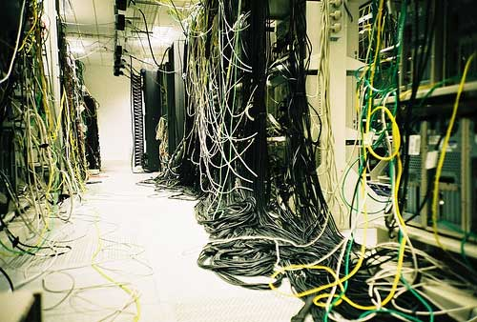
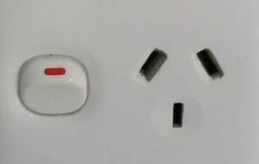
← less of this
more like this → …

Slide 6
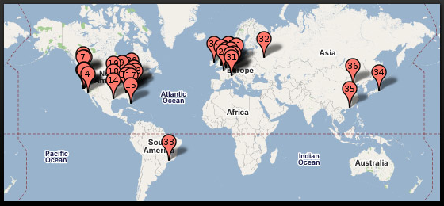
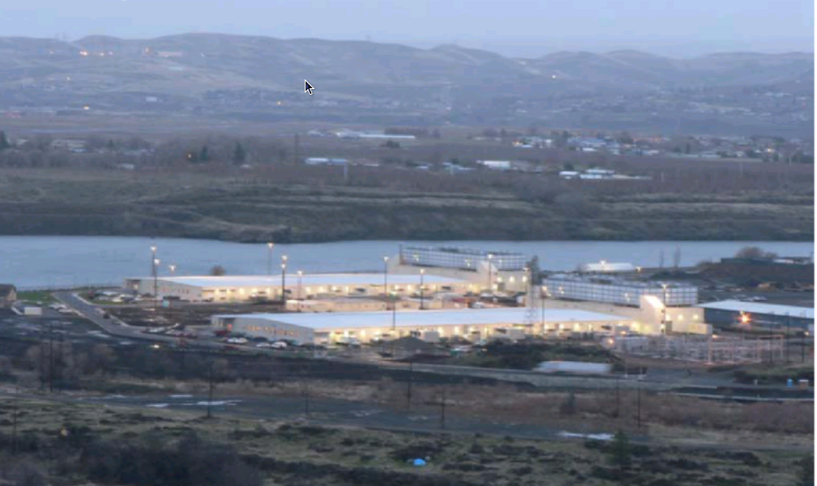
...connected to these →
Notes:
Google’s Oregon data centre on the Colorado river
NB Google building USD120M DC in Singapore (+Taiwan and HK), operational by 2013. NO DC in Australia.

Slide 7
What does this mean?
Two major shifts concurrently: it’s going to be quite a ride
mobile:
consumers (clients?) increasingly expect service 24x7 from palms of their hands
cloud:
we are back to centralised computing again
there are significant opportunities and risks in re-organising to use cloud services

Slide 8
Opportunities – cost reduction
reduce local IT headcount, servers, storage, licence costs, depreciation/replacement cost
Product Name | Type | Cost (/user/month)
Google Apps | Productivity & docs, email, calendar, contacts | $5
Microsoft Office 365 | Email, calendar, contacts, office web apps, doc storage, collaboration tools | $8
Salesforce | Customer relationship management | $21-$180
Rocket Matter | Legal practice management | $50
Clio | Legal practice management | $25-$50
LawRD | Legal practice management | $19
Gomatters | Legal practice management | $8-$16
Notes:
Dropbox for storage slightly different model, charging for storage ($20/100GB/month), or for teams ($13/user/month for 5 users)

Slide 9
Opportunities – cost predictability
the cost is predictable (subject to agreement) and certainly more predictable than in-house costs
there is not usually an additional cost for upgrades (check with the provider)

Slide 10
Opportunities – ubiquity
nature of cloud services is to be available anywhere there is internet connectivity
mobile devices
out-of-office locations
reduce “synchronisation” issues
improve security
fewer copies particularly on notebooks, data sticks
Notes:
By synchronisation issues I mean making a copy on your notebook, and on a data stick, and emailing it to yourself
About 2.3% of notebooks are lost or stolen each year (about 30M); 7% of notebooks lost/stolen in their useful life
An interesting stat: more than 1M notebooks are lost just at airports each year, ~60% are returned to lost-and-found, where almost none are claimed

Slide 11
Opportunities – service levels
replication, redundancy, scale, dedicated organisation = higher quality service
eg, both Microsoft and Google offer 99.9% availability, even on low-end cloud products
ie, down no more than 43 minutes/month
much better than the average for in-house systems
should include SLA expectations in services agreement, though will not be a stop-loss
Notes:
Gold standard is “five nines” or 99.999% uptime = just over 5 minutes/year down
Windows Azure (component-based) offers 99.95%
It’s not that personnel are better or worse, it’s just that the high-availability infrastructure is cost-prohibitive unless you operate at a massive scale. For example, I worked on the <client> agreement for <govt-personal> records: clearly high-availability is required. The cost of achieving the high-availability required (compared with the cost of the system which would just “do the job” but have no failover redundancy) almost doubled the infrastructure cost.

Slide 12
Opportunities – service abstraction
great technology is invisible
allows users (ie, lawyers & support staff) to get on with what we’re good at
cloud technologies are particularly good for abstracting those details
only have to make sure one thing’s working (ie, internet connectivity, usually)
best case, everything else “just works”
Notes:
This is the big advantage that gets lost when we start talking about the details
People say, that’s always been the promise of IT, but it really works in the cloud because the implementation details are deliberately abstracted away. That’s the whole point of the cloud metaphor.

Slide 13
Choosing a provider
scale drives internet businesses
provide a “scalable” standard service at a low price
very low direct interaction
high level of automation / self-help
smaller providers may provide more personalised assistance
Notes:
Eg, amazon web services (AWS) offers cloud-based building blocks, which could be combined into a package offered by a smaller provider

Slide 14
Choosing a provider
smaller/custom providers may use larger providers as “back end” components
eg, AWS, AppEngine, Azure
if service provider will not itself host, then find out who will host and where
privacy and security arrangements depend on data centre as much as service provider
understand what’s going on (with data, at the start, “you don’t need to know” is unhelpful)

Slide 15
Choosing a provider
compliance and certification – formal standards for data centres
ANSI/TIA-942 or Uptime Institute “Tier” certification: Tier 4 is the most stringent
might also see PCI DSS (credit-card standard) or FISMA/HIPAA (US federal regulatory standards for government and health)
ISO/IEC 27000 is an information security standard for all types of organisation
other customers?
Notes:
Tell story of client looking for UI Tier 3 DC in Qld, none available
Certification scam (like QA)

Slide 16
Issues – data sovereignty
the Big Issue with cloud services
your data (and your clients’) does not reside on your own infrastructure
right and continuity of access
security / confidentiality
compliance
jurisdiction
Notes:
Good metaphor is an outsourced file storage and management company (eg sending all your files to Recall, because you don’t want to pay for file storage space in your office) BUT they store your files in different locations in the warehouse a page at a time and only they know how to re-assemble them. Oh, and they outsourced the actual warehouse, and it’s in the Ukraine.

Slide 17
Right and continuity of access
address in services contract
contract should allow access / take copy / periodically obtain copy of data
should be provided in an appropriate exchange format
may be different from provider’s own internal format, which may be proprietary
should address insolvency, control change

Slide 18
Security / confidentiality
Legal Profession (Solicitors) Rule 2007 Rule 3 – Confidentiality
prohibits disclosure of confidential client information without client authorisation
may need to amend retainer to provide for authorisation to use service provider
service provider should (of course) itself be bound to strict confidentiality obligations
Notes:
Confidentiality
A solicitor must never disclose to any person, who is not a partner or employee of the solicitor’s
law practice, any information which is confidential to a client and acquired by the solicitor or by the
solicitor’s law practice during the client’s retainer, unless:
3.1 the client authorises disclosure;
3.2 the solicitor is permitted or compelled by law to disclose;
3.3 the solicitor discloses the information to a particular person in circumstances in which the
solicitor believes on reasonable grounds that the law would compel its disclosure to that
person, whether or not a client makes a claim of legal professional privilege or confidentiality;
3.4 the solicitor discloses the information to a particular person in circumstances in which the
solicitor believes on reasonable grounds that it is necessary to disclose that information to
that person for the sole purpose of avoiding the probable commission of a serious offence;
3.5 the information has lost its confidentiality;
3.6 the solicitor obtains the information from another person who is not bound by the
confidentiality owed by the solicitor to the client and who does not give the information
confidentially to the solicitor; or
3.7 in the solicitor’s opinion the disclosure of the information is required to prevent imminent
serious physical harm to the client or to another person

Slide 19
Information privacy compliance
NPP4 Data Security: must take reasonable steps to protect personal information
should be reflected in service provider agreement
NPP9 Transborder data flows: o’seas recipient must be bound by similar privacy law
should take care to determine which jurisdiction the data is located/stored in, if not Australia
NPP compliance generally should be reflected in provider agreement in specific terms

Slide 20
Information privacy compliance
Concerns about government access
“library records” provision of USA PATRIOT Act allows access to records of entities located in the US, or which are US-based
Bank of Valletta v NCA [1999] FCA required an Australian branch of a foreign bank to produce o’seas documents in Australian criminal proceedings
Australia is party to a number of mutual legal assistance treaties allowing access to data for the purpose of criminal investigations
Notes:
There was some minor hysteria last year when Microsoft launched its Office 365 cloud product, and some enterprising journalist asked Microsoft in the UK whether, because they were a US company, customers’ data would be subject to access under the Patriot Act (“Uniting (and) Strengthening America (by) Providing Appropriate Tools Required (to) Intercept (and) Obstruct Terrorism Act of 2001”), and Microsoft said yes it would.
It turns out that’s right, but it was probably always the case, even in the absence of the Patriot Act, and that other countries including Australia have that right as well when investigating criminal behaviour.
Incidentally (and ironically), does anyone know how the Sept 11 conspirators communicated with one another? Hotmail (save as draft)

Slide 21
Encryption & destruction
contract should provide
encryption on-disk and on-the-wire
data will be entirely deleted (including backups) when the agreement ends
difficult to police: have to trust contract and behaviour of the provider
frequently hear of used PC’s and drives bought with old data still present
Notes:
TLS on web-interaction: automated tool called firesheep

Slide 22
Issues – disaster recovery
contract should identify provider’s DR plan
any size organisation should have one
less material for Amazon, Google, et al who have multiple redundant data centres
and YOU should have a DR plan
in the case the provider just suddenly disappears
cf MegaUpload

Slide 23
Liability and risk allocation
difficult to avoid ICT industry-standard terms on liability and risk
cap on total liability, typically related to the price (best case, a multiple of the price)
exclusion of consequential loss
breach of SLAs (eg, uptime) typically results in service credit
possibly indemnity from liability to others
Notes:
Likely worse, the larger the provider
May not even be willing to discuss the issue: heavy reliance on standard form terms.

Slide 24
Changing providers
ensure you have your data (backup) in hand before advising of change
could include “transition out” terms in agreement, but difficult to contract for genuine assistance
have appropriate notice periods
some providers notoriously unhelpful
Notes:
Tell story of a legal practice management “cloud” vendor who was paid in advance for 3 months, but was told before the three month period started that the client was going elsewhere at the end of the period. Refunded the payment and told them they were turned off as at 5pm the next Friday.

Slide 25
Other risks for lawyers: privilege
confidentiality critical to the preservation of privilege in client correspondence
agreement should contain:
strict confidentiality provisions
provisions dealing with what the provider must do if documents are sought from it, or if relevant legal action is threatened against it (ie, contact you immediately!)

Slide 26
Other risks for lawyers: liens
if file in someone else’s hands, more difficult to enforce your lien
agreement with supplier should prevent supplier from delivering file directly to client, or subject to approval only
some providers seek lien over data to secure own payments: obviously high risk

Slide 27
Thank you
Patrick Sefton Principal, Brightline Lawyers Ph 07 3160 9249 Mob 0407 756 568 patrick.sefton@brightline.com.au

